Slide 1
Headline Hindsight
Irti Haq
Irtihaq@uw.edu
Andrew Simon
simona6@uw.edu
Jeleen Limawan
je0110@uw.edu
Joeph Rafael
joephr@uw.edu
Notes:
Introduce team members - say something about project overall - bringing visibility on biases in headlines?

Slide 2
Project Motivation
Headlines grab readers' attention and entice them to explore further. They document our history and educate those in the present day. Headlines shape perceptions, provide context, and serve as a crucial link between history and the present.
Why is this project important?

Slide 3
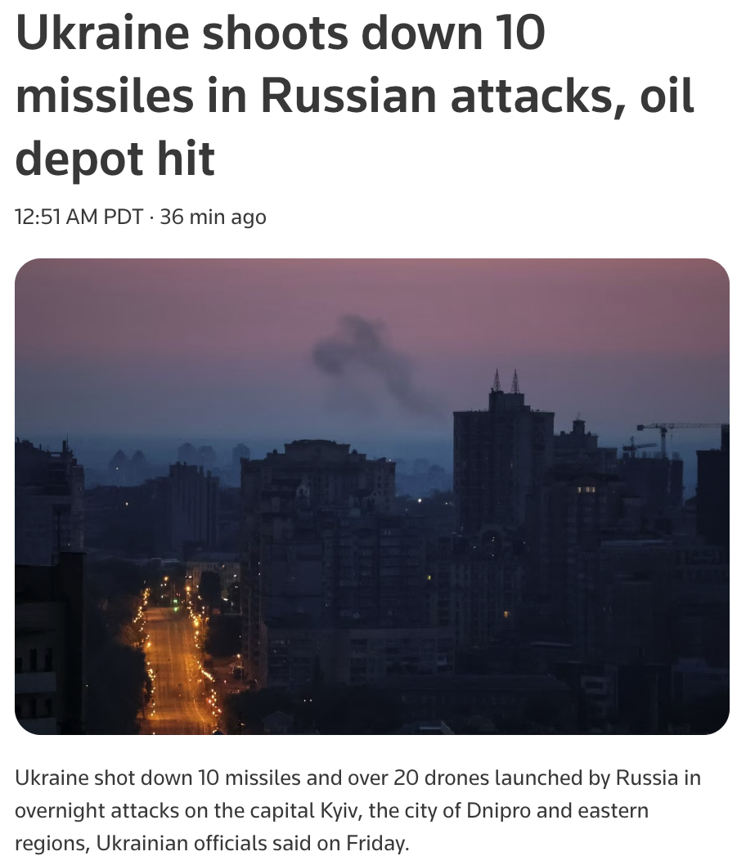
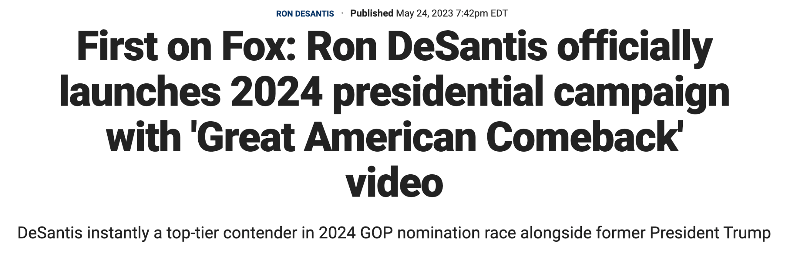
Project Goals
To document the essence of this turbulent time
To capture and communicate biases in major news publications

Slide 4
Project Motivation
Headlines alone can influence politics, social movements, and the public. When used incorrectly, it can become a dangerous and powerful tool. We want to bring visibility on past headlines and their potential biases.
How does it relate to social and/or scientific importance?

Slide 5
Key Questions
What were the most common words brought up in news headlines and how has this varied over time?
What are some of the biggest news topics and how have they varied over time?
What is the distribution and differences in the coverage of certain topics and events among the major news publications?

Slide 6


Approach
2.7 Million
Vega Altair, Tensorflow,
Matplotlib, Scikit Learn, Plotly in Google Colab
American citizens with knowledge of political sphere
All the News 2.0 — 2.7 million news articles and essays from 27 American publications - Components
Notes:
To address these questions, we designed an interactive notebook using Vega Altair, Matplotlib, and Tensorflow in Google Colab
Our intended audience is Americans citizens who are somewhat interested in US political news. We are assuming that our readers have some knowledge on the American political sphere and are aware of major events that took place 2016-2020
We used a dataset of roughly 2.7 million articles collected from 2016-2020. We did a lot of preprocessing to ensure that the data was fit to use. We know the dataset is credible because its been used in multiple academic papers.

Slide 7
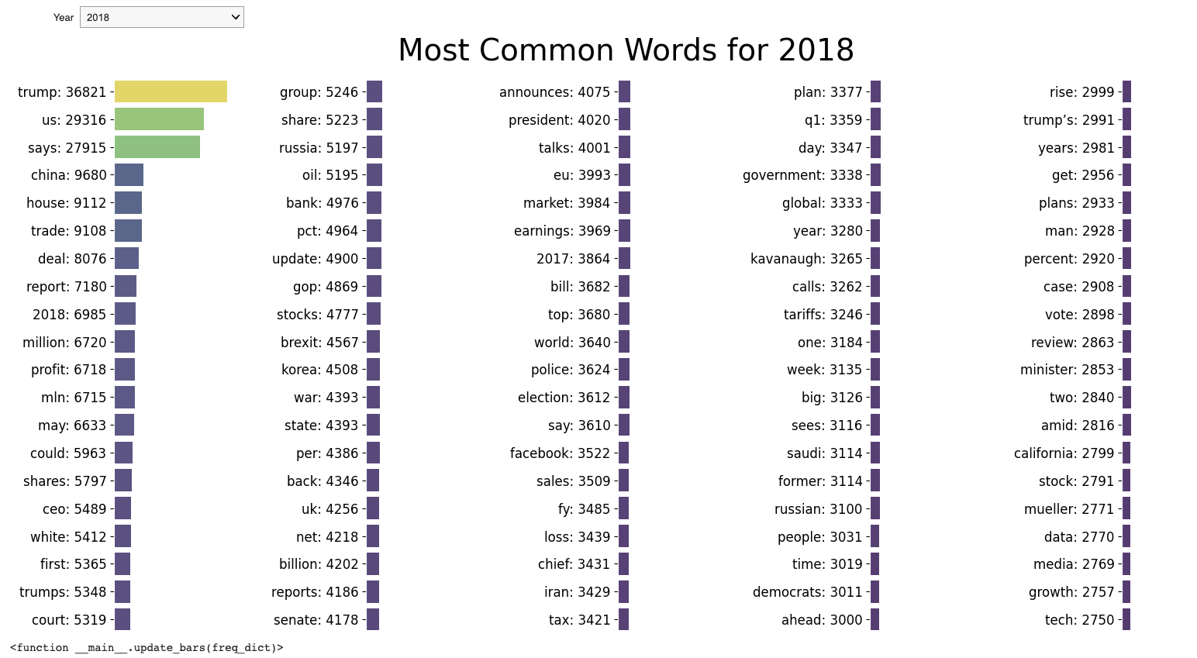
What were the most common words brought up in news headlines and how has this varied over time?
Bar chart of the most common words in news headlines.
Color (Purple (Low) to Yellow (High)) and Size Used to Encode Number of Words in the Dataset
A dropdown is also available so viewers can filter out the specific year.
Notes:
Link: https://colab.research.google.com/drive/1GdG6mq2tDLAWhj9I-Gkv2TWDhMfmj9Xm?usp=sharing
Our visualization shows a bar chart of the most common words in news headlines.
The color yellow represents words with many occurrences, while blue is used to represent words with few occurrences. A dropdown is also available so viewers can filter out the specific year.

Slide 8
Link to Notebook: https://colab.research.google.com/drive/1GdG6mq2tDLAWhj9I-Gkv2TWDhMfmj9Xm?authuser=2#scrollTo=6NbyN5MbdmHf

Slide 9
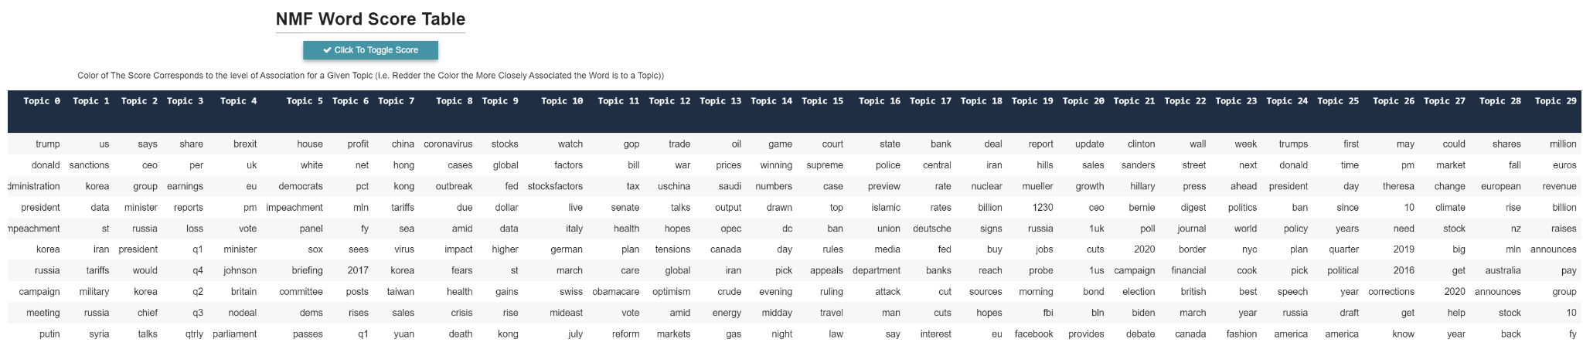
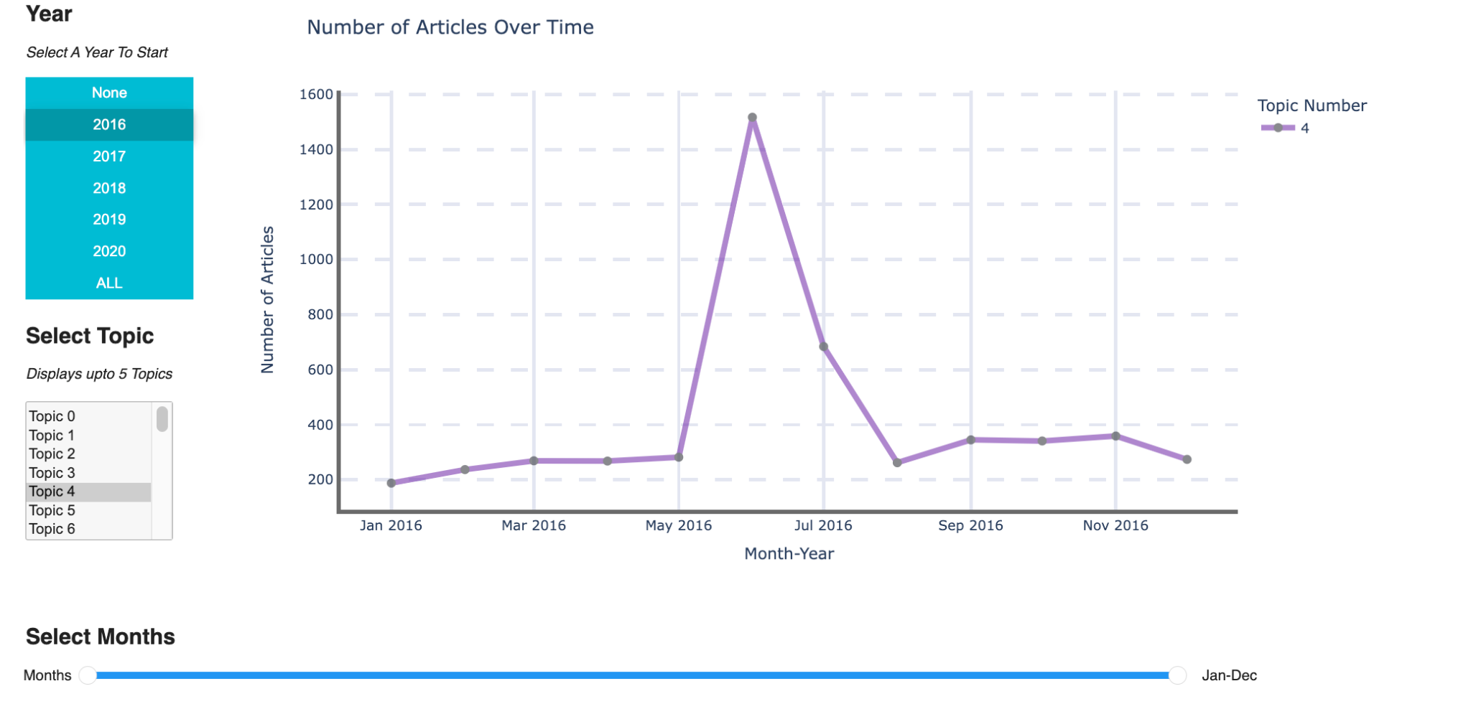
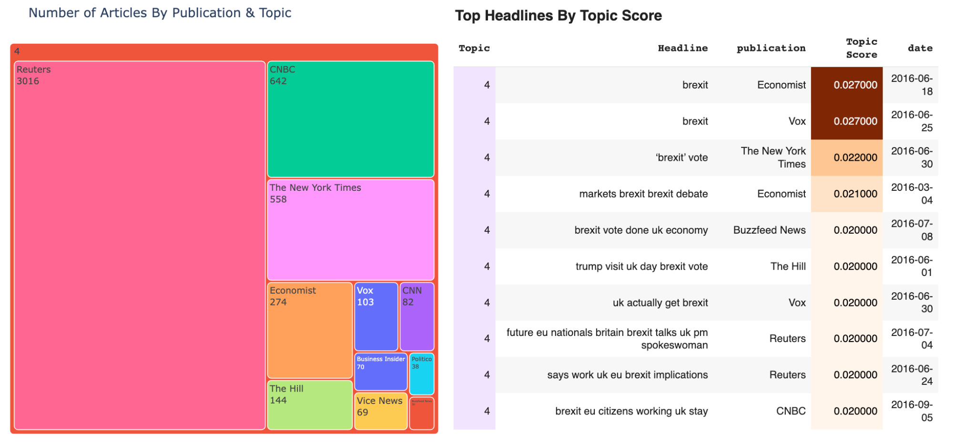
What are some of the biggest news topics and how have they varied over time?
Insert description
Notes:
Visualization 2

Slide 10
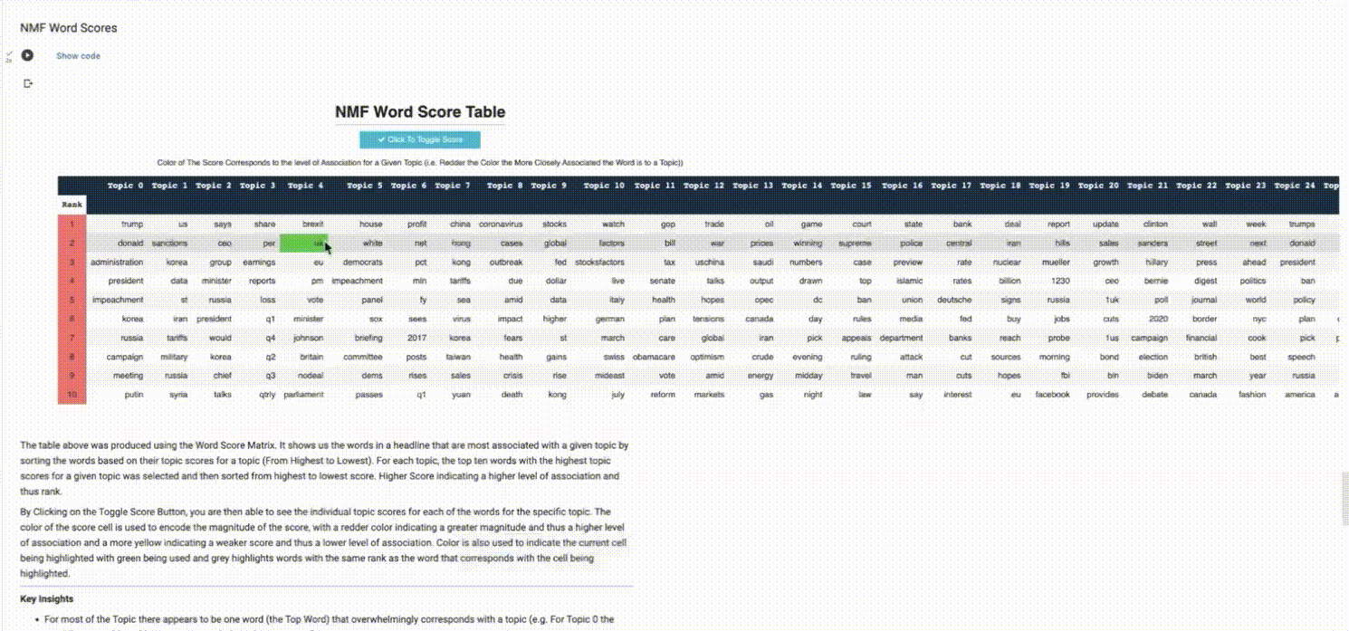
Link to Notebook: https://colab.research.google.com/drive/1GdG6mq2tDLAWhj9I-Gkv2TWDhMfmj9Xm?authuser=2#scrollTo=6NbyN5MbdmHf

Slide 11
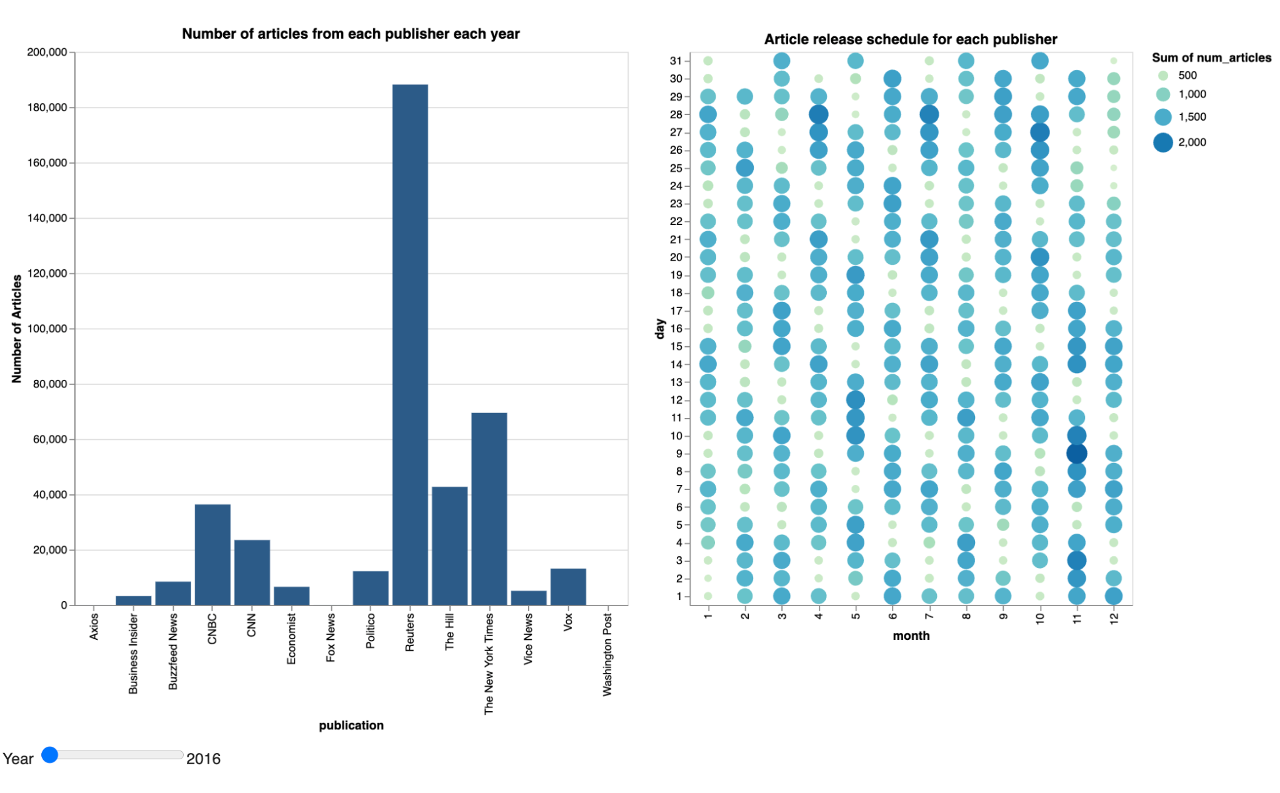
What is the distribution and differences in the coverage of certain topics and events among the major news publications?
This visualization shows each major publication and the number of articles released from each in a given year.
Select publication by clicking on the bar chart, and the circle chart will display the overall distribution of articles released within that year.
Readers can use this visualization by mapping an event to it and see how different news publications responded.
Notes:
Visualization 2

Slide 12
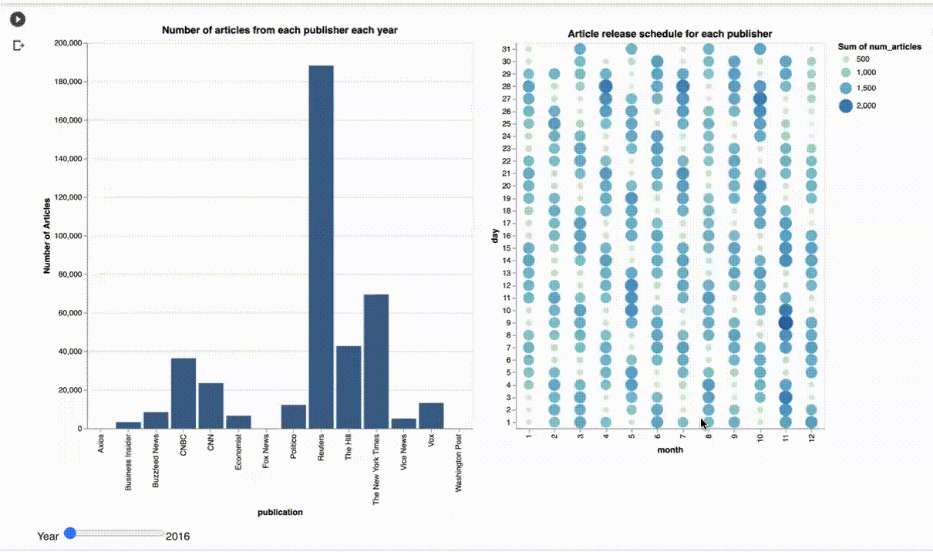
Link to Notebook: https://colab.research.google.com/drive/1GdG6mq2tDLAWhj9I-Gkv2TWDhMfmj9Xm?authuser=2#scrollTo=6NbyN5MbdmHf

Slide 13
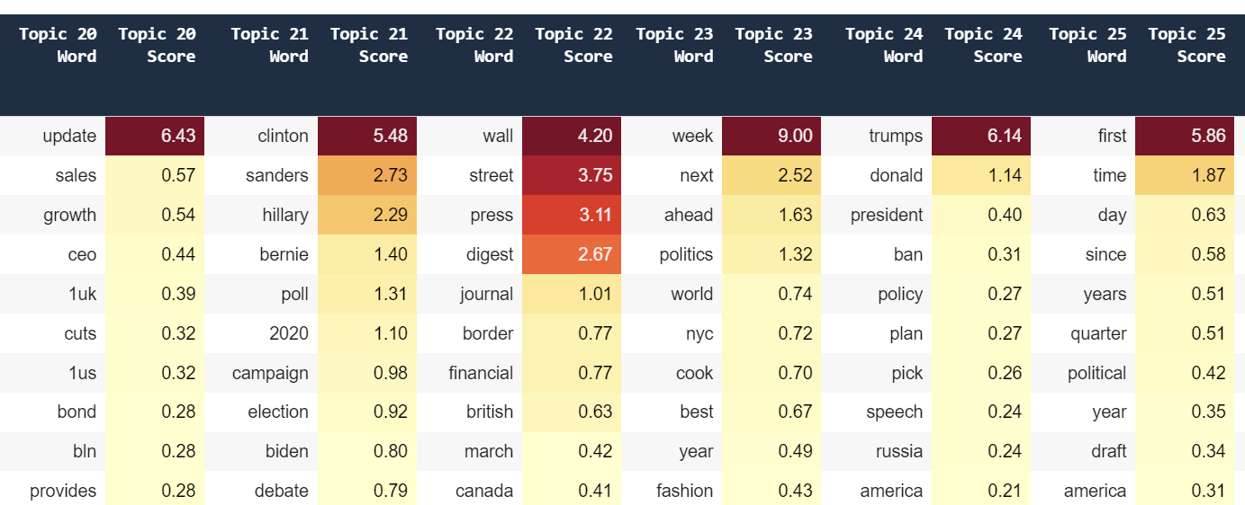
Conclusion
Limitations:
This dataset is from 2016 - 2020 (partially), so it might not be totally accurate in regards to today’s events
Certain Publications seem to have been overrepresented in our dataset (e.g. Reuters)
The NMF model could benefit from additional hyper-parameter tuning.
While certain topics are coherent others don’t make much sense
The Dataset could be cleaned up a bit more
Opportunities For Further Exploration
Apply Sentiment Analysis to the Dataset
Compare Headlines vs The Article as a Whole see if there are differences

